Slide 1

Data Management Using Microsoft SQL Server
SQL
Server
2012
Session: 1
Introduction to the Web
Session: 10
Using Views, Stored Procedures, and Querying Metadata

Slide 2

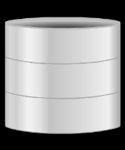

SQL
Server
2012
SQL
Server
2012
Define views
Describe the technique to create, alter, and drop views
Define stored procedures
Explain the types of stored procedures
Describe the procedure to create, alter, and execute stored
procedures
Describe nested stored procedures
Describe querying SQL Server metadata
System Catalog views and functions
Querying Dynamic Management Objects

Slide 3

SQL
Server
2012
SQL
Server
2012
An SQL Server database has two main categories of objects:
those that store data.
those that access, manipulate, or provide access to data.
Views and stored procedures belong to this latter category.

Slide 4

SQL
Server
2012
SQL
Server
2012
 | A view is a virtual table that is made up of selected columns from one or more
 | tables.
The tables from which the view is created are referred to as base tables.
These base tables can be from different databases.
A view can also include columns from other views created in the same or a
different database.
A view can have a maximum of 1024 columns.
The data inside the view comes from the base tables that are referenced in the view definition.
The rows and columns of views are created dynamically when the view is referenced.

Slide 5


SQL
Server
2012
SQL
Server
2012
A view is created using the CREATE VIEW statement and it can be created only in the current database.
SQL Server verifies the existence of objects that are referenced in the view
definition.
The syntax used to create a view is as follows:
Syntax:
CREATE VIEW <view_name>
AS <select_statement>
where,
view_name: specifies the name of the view.
select_statement: specifies the SELECT statement that defines the view.

Slide 6

SQL
Server
2012
SQL
Server
2012
Following code snippet creates a view from the Product table to display only the product id, product number, name, and safety stock level of products.
CREATE VIEW vwProductInfo AS
SELECT ProductID, ProductNumber, Name, SafetyStockLevel
FROM Production.Product; GO
The code in the following code snippet is used to display the details of the
vwProductInfo view.
SELECT * FROM vwProductInfo

Slide 7

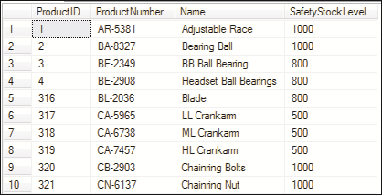
SQL
Server
2012
SQL
Server
2012
The result will show the specified columns of all the products from the Product
table.
The following figure shows a part of the output.

Slide 8
SQL
Server
2012
SQL
Server
2012
The JOIN keyword can also be used to create views.
The syntax used to create a view with the JOIN keyword is as follows:
Syntax:
CREATE VIEW <view_name>
AS
SELECT * FROM table_name1 JOIN table_name2
ON table_name1.column_name = table_name2.column_name
where,
view_name: specifies the name of the view.
table_name1: specifies the name of first table.
JOIN: specifies that two tables are joined using JOIN keyword.
table_name2: specifies the name of the second table.

Slide 9
SQL
Server
2012
SQL
Server
2012
Following code snippet creates a view named vwPersonDetails with specific columns from the Person and Employee tables.
The JOIN and ON keywords join the two tables based on BusinessEntityID
column.
CREATE VIEW vwPersonDetails
AS
SELECT
p.Title
,p.[FirstName]
,p.[MiddleName]
,p.[LastName]
,e.[JobTitle]
FROM [HumanResources].[Employee] e INNER JOIN [Person].[Person] p
ON p.[BusinessEntityID] = e.[BusinessEntityID]
GO
This view will contain the columns Title, FirstName, MiddleName, and
LastName from the Person table and JobTitle from the Employee table.

Slide 10
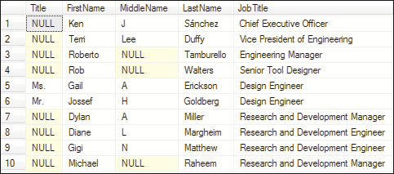
SQL
Server
2012
SQL
Server
2012
The following figure displays the output.
As shown in the figure, all the rows may not have values for the Title or
MiddleName columns - some may have NULL in them.
A person seeing this output may not be able to comprehend the meaning of the
NULL values.

Slide 11
SQL
Server
2012
SQL
Server
2012
The following code snippet replaces all the NULL values in the output with a null string using the COALESCE() function.
CREATE VIEW vwPersonDetails AS
SELECT
COALESCE(p.Title, ' ') AS Title
,p.[FirstName]
,COALESCE(p.MiddleName, ' ') AS MiddleName
,p.[LastName]
,e.[JobTitle]
FROM [HumanResources].[Employee] e INNER JOIN [Person].[Person] p
ON p.[BusinessEntityID] = e.[BusinessEntityID]
GO

Slide 12
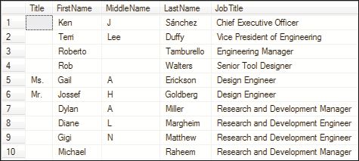
SQL
Server
2012
SQL
Server
2012
When this view is queried with a SELECT statement, the output will be as shown in the following figure:

Slide 13
SQL
Server
2012
Before creating a view, the following guidelines and restrictions should be considered:
A view can be created using the CREATE VIEW command.
SQL
Server
2012
View names must be unique and cannot be the same as the table names in the schema.
A view cannot be created on temporary tables. A view cannot have a full-text index.
A view cannot contain the DEFAULT definition.
 | The CREATE VIEW statement can include the ORDER BY clause only if the TOP keyword is
 | used.
Views cannot reference more than 1024 columns.
The CREATE VIEW statement cannot include the INTO keyword.
 | The CREATE VIEW statement cannot be combined with other Transact-SQL statements in a
 | single batch.

Slide 14
SQL
Server
2012
Following code snippet reuses the code given earlier with an ORDER BY
SQL
Server
2012
clause.
CREATE VIEW vwSortedPersonDetails AS
SELECT TOP 10
COALESCE(p.Title, ' ') AS Title
,p.[FirstName]
,COALESCE(p.MiddleName, ' ') AS MiddleName
,p.[LastName]
,e.[JobTitle]
FROM [HumanResources].[Employee] e
INNER JOIN [Person].[Person] p
ON p.[BusinessEntityID] = e.[BusinessEntityID] ORDER BY p.FirstName
GO
--Retrieve records from the view
SELECT * FROM vwSortedPersonDetails
The TOP keyword displays the name of the first ten employees with their first names in ascending order.

Slide 15
SQL
Server
2012
SQL
Server
2012
The INSERT statement is used to add a new row to a table or a view. The value of column is automatically provided if:
The column has an IDENTITY property.
The column has a default value specified.
The column has a timestamp data type.
The column takes null values.
The column is a computed column.
While using the INSERT statement on a view, if any rules are violated, the record
is not inserted.

Slide 16
SQL
Server
2012
SQL
Server
2012
In the following example, when data is inserted through the view, the insertion does not take place as the view is created from two base tables.
First, create a table Employee_Personal_Details as shown in the following
code snippet:
CREATE TABLE Employee_Personal_Details
(
EmpID int NOT NULL,
FirstName varchar(30) NOT NULL, LastName varchar(30) NOT NULL, Address varchar(30)
)
Then, create a table Employee_Salary_Details as shown in the following code
snippet:
CREATE TABLE Employee_Salary_Details
(
EmpID
int NOT NULL,
Designation varchar(30), Salary int NOT NULL
)

Slide 17
SQL
Server
2012
SQL
Server
2012
Following code snippet creates a view vwEmployee_Details using columns from the Employee_Personal_Details and Employee_Salary_Details tables by joining the two tables on the EmpID column.
CREATE VIEW vwEmployee_Details
AS
SELECT e1.EmpID, FirstName, LastName, Designation, Salary FROM Employee_Personal_Details e1
JOIN Employee_Salary_Details e2
ON e1.EmpID = e2.EmpID
Following code snippet uses the INSERT statement to insert data through the view
vwEmployee_Details.
INSERT INTO vwEmployee_Details VALUES (2,'Jack','Wilson','Software
Developer',16000)
However, the data is not inserted as the view is created from two base tables.
The following error message is displayed when the INSERT statement is executed.
'Msg 4405, Level 16, State 1, Line 1
View or function 'vEmployee_Details' is not updatable because the modification affects multiple base tables.'

Slide 18
SQL
Server
2012
Values can be inserted into user-defined data type columns by:
Specifying a value of the user-defined type.
SQL
Server
2012
Calling a user-defined function that returns a value of the user-defined type.
The following rules and guidelines must be followed when using the INSERT
statement:
 | The INSERT statement must specify values for all columns in a view in the
 | underlying table that do not allow null values and have no DEFAULT definitions.
When there is a self-join with the same view or base table, the INSERT statement does not work.

Slide 19
SQL
Server
2012
SQL
Server
2012
Following code snippet creates a view vwEmpDetails using
Employee_Personal_Details table.
CREATE VIEW vwEmpDetails
AS
SELECT FirstName, Address FROM Employee_Personal_Details GO
The Employee_Personal_Details table contains a column named LastName
that does not allow null values to be inserted.
Following code snippet attempts to insert values into the vwEmpDetails view.
INSERT INTO vwEmpDetails VALUES ('Jack','NYC')
This insert is not allowed as the view does not contain the LastName column from the base table and that column does not allow null values.

Slide 20
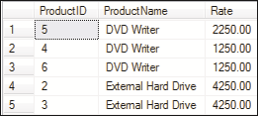
SQL
Server
2012
SQL
Server
2012
The UPDATE statement can be used to change the data in a view.
Updating a view also updates the underlying table.
Following code snippet creates a table named Product_Details.
CREATE TABLE Product_Details
(
ProductID int, ProductName varchar(30), Rate money
)
Assume some records are added in the table as shown in the following figure:

Slide 21
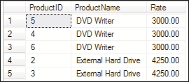
SQL
Server
2012
Following code snippet creates a view based on the Product_Details table.
SQL
Server
2012
CREATE VIEW vwProduct_Details
AS SELECT
ProductName, Rate FROM Product_Details
Following code snippet updates the view to change all rates of DVD writers to 3000.
UPDATE vwProduct_Details
SET Rate=3000
WHERE ProductName='DVD Writer'
The outcome of this code affects not only the view, vwProduct_Details, but also the underlying table from which the view was created.
Following figure shows the updated table which was automatically updated because of the view.

Slide 22
SQL
Server
2012
SQL
Server
2012
Large value data types include varchar(max), nvarchar(max), and
varbinary(max).
To update data having large value data types, the .WRITE clause is used.
The .WRITE clause specifies that a section of the value in a column is to be modified.
The .WRITE clause cannot be used to update a NULL value in a column.
Also, it cannot be used to set a column value to NULL.
Syntax:
column_name .WRITE (expression, @Offset, @Length)
where,
column_name: specifies the name of the large value data-type column.
Expression: specifies the value that is copied to the column.
@Offset: specifies the starting point in the value of the column at which the expression is written.
@Length: specifies the length of the section in the column.
@Offset and @Length are specified in bytes for varbinary and varchar data types and in characters for the nvarchar data type.

Slide 23
SQL
Server
2012
SQL
Server
2012
Assume that the table Product_Details is modified to include a column
Description having data type nvarchar(max).
The following code snippet creates a view based on this table, having the columns
ProductName, Description, and Rate.
CREATE VIEW vwProduct_Details
AS SELECT
ProductName,
Description,
Rate FROM Product_Details
Following code snippet uses the UPDATE statement on the view
vwProduct_Details.
The .WRITE clause is used to change the value of Internal in the Description
column to External.
UPDATE vwProduct_Details
SET Description .WRITE(N'Ex',0,2) WHERE ProductName='Portable Hard Drive'
All the rows in the view that had 'Portable Hard Drive' as product name will be updated with External instead of Internal in the Description column.

Slide 24
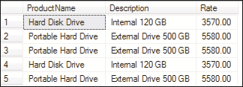
SQL
Server
2012
SQL
Server
2012
Following figure shows a sample output of the view after the updation.
The following rules and guidelines must be followed when using the UPDATE
statement:
The value of a column with an IDENTITY property cannot be updated.
Records cannot be updated if the base table contains a TIMESTAMP column.
While updating a row, if a constraint or rule is violated, the statement is terminated, an error is returned, and no records are updated.
When there is a self-join with the same view or base table, the UPDATE statement
does not work.

Slide 25
SQL
Server
2012
SQL
Server
2012
Rows can be deleted from the view using the DELETE statement.
When rows are deleted from a view, corresponding rows are deleted from the base table.
For example, consider a view vwCustDetails that lists the account information of
different customers.
When a customer closes the account, the details of this customer need to be deleted.
The syntax used to delete data from a view is as follows:
Syntax:
DELETE FROM <view_name>
WHERE <search_condition>
Assume that a table named Customer_Details and a view vwCustDetails
based on the table are created.
Following code snippet is used to delete the record from the view vwCustDetails
that has CustID C0004.
DELETE FROM vwCustDetails WHERE CustID='C0004‘

Slide 26
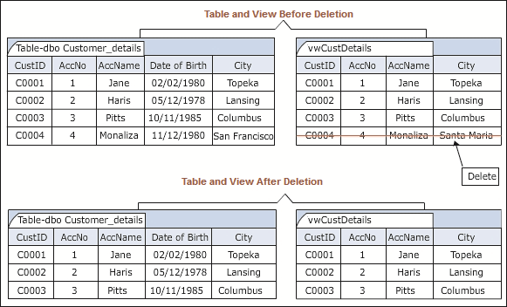
SQL
Server
2012
SQL
Server
2012
Following figure depicts the logic of deleting from views.

Slide 27
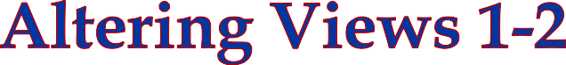


SQL
Server
2012
SQL
Server
2012
Besides modifying the data within a view, users can also modify the definition of a
view.
The ALTER VIEW statement modifies an existing view without having to reorganize its permissions and other properties.
Views are often altered when a user requests for additional information or makes
changes in the underlying table definition.

Slide 28
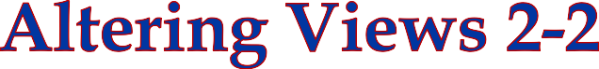
SQL
Server
2012
The syntax used to alter a view is as follows:
Syntax:
SQL
Server
2012
ALTER VIEW <view_name>
AS <select_statement>
Following code snippet alters the view, vwProductInfo to include the
ReOrderPoint column.
ALTER VIEW vwProductInfo AS
SELECT ProductID, ProductNumber, Name, SafetyStockLevel, ReOrderPoint
FROM Production.Product; GO

Slide 29

SQL
Server
2012
SQL
Server
2012
A view can be removed from the database using the DROP VIEW statement.
When a view is dropped, the data in the base tables remains unaffected.
The definition of the view and other information associated with the view is deleted from the system catalog.
All permissions for the view are also deleted.
The syntax used to drop a view is as follows:
Syntax:
DROP VIEW <view_name>
Following code snippet deletes the view, vwProductInfo.
DROP VIEW vwProductInfo

Slide 30
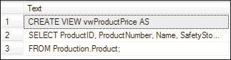
SQL
Server
2012
SQL
Server
2012
The definition of a view helps to understand how its data is derived from the source tables.
The sp_helptext stored procedure displays view related information when the
name of the view is given as its parameter.
The syntax used to view the definition information of a view is as follows:
Syntax:
sp_helptext <view_name>
Following code snippet displays information about the view, vwProductPrice.
EXEC sp_helptext vwProductPrice
The execution of the code will display the definition about the view as shown in the following figure.

Slide 31
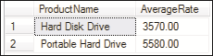
SQL
Server
2012
SQL
Server
2012
When functions are used, the derived column must include the column name in the
CREATE VIEW statement.
Consider the view that was created in the following code snippet to make use of the
AVG() function.
CREATE VIEW vwProduct_Details
AS SELECT
ProductName,
AVG(Rate) AS AverageRate FROM Product_Details GROUP BY ProductName
Here, the AVG() function calculates the average rate of similar products by using a
GROUP BY clause.
Following figure shows the result when the view is queried.

Slide 32
SQL
Server
2012
SQL
Server
2012
The CHECK OPTION is used to enforce domain integrity; it checks the definition of the view to see that the WHERE conditions in the SELECT statement is not violated.
The syntax used to create a view using the CHECK OPTION is as follows:
Syntax:
CREATE VIEW <view_name>
AS select_statement [ WITH CHECK OPTION ]
where,
WITH CHECK OPTION: specifies that the modified data in the view continues to
satisfy the view definition.

Slide 33
SQL
Server
2012
SQL
Server
2012
Following code snippet re-creates the view vwProductInfo having
SafetyStockLevel less than or equal to 1000:
CREATE VIEW vwProductInfo AS
SELECT ProductID, ProductNumber,Name,SafetyStockLevel, ReOrderPoint
FROM Production.Product WHERE SafetyStockLevel <=1000 WITH CHECK OPTION;
GO
In the following code snippet, the UPDATE statement is used to modify the view vwProductInfo by changing the value of the SafetyStockLevel column for the product having id 321 to 2500.
UPDATE vwProductInfo SET SafetyStockLevel= 2500 WHERE ProductID=321
The UPDATE statement fails to execute as it violates the view definition, which specifies that SafetyStockLevel must be less than or equal to 1000.
Thus, no rows are affected in the view vwProductInfo.

Slide 34
SQL
Server
2012
SQL
Server
2012
A view can be bound to the schema of the base table using the SCHEMABINDING
option.
The view definition must be first modified or deleted to remove dependencies on the table that is to be modified.
The syntax used to create a view with the SCHEMABINDING option is as follows:
Syntax:
CREATE VIEW <view_name> WITH SCHEMABINDING
AS <select_statement>
where,
view_name: specifies the name of the view.

Slide 35
SQL
Server
2012
SQL
Server
2012
WITH SCHEMABINDING: specifies that the view must be bound to a schema.
select_statement: specifies the SELECT statement that defines the view.
Following code snippet creates a view vwNewProductInfo with SCHEMABINDING option to bind the view to the Production schema, which is the schema of the table Product.
CREATE VIEW vwNewProductInfo
WITH SCHEMABINDING AS
SELECT ProductID, ProductNumber, Name, SafetyStockLevel FROM Production.Product;
GO

Slide 36




SQL
Server
2012
SQL
Server
2012
The sp_refreshview stored procedure updates the metadata for the view.
If the sp_refreshview procedure is not executed, the metadata of the view is not updated to reflect the changes in the base tables.
This results in the generation of unexpected results when the view is queried.
The sp_refreshview stored procedure returns code value zero if the execution is
successful or returns a non-zero number in case the execution has failed.
The syntax used to run the sp_refreshview stored procedure is as follows:
Syntax:
sp_refreshview '<view_name>‘
Following code snippet creates a table Customers with the CustID, CustName, and Address columns.
CREATE TABLE Customers
(
CustID int,
CustName varchar(50), Address varchar(60)
)

Slide 37
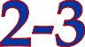
SQL
Server
2012
SQL
Server
2012
Following code snippet creates a view vwCustomers based on the table
Customers.
CREATE VIEW vwCustomers
AS
SELECT * FROM Customers
Following code snippet executes the SELECT query on the view.
SELECT * FROM vwCustomers
The output will show three columns, CustID, CustName, and Address.
Following code snippet uses the ALTER TABLE statement to add a column Age to
the table Customers.
ALTER TABLE Customers ADD Age int
Following code snippet executes the SELECT query on the view.
SELECT * FROM vwCustomers

Slide 38
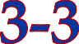
SQL
Server
2012
SQL
Server
2012
The updated column Age is not seen in the view.
To resolve this, the sp_refreshview stored procedure must be executed on the view vwCustomers as shown in the following code snippet:
EXEC sp_refreshview 'vwCustomers‘
When a SELECT query is run again on the view, the column Age is seen in the output.
This is because the sp_refreshview procedure refreshes the metadata for the
view vwCustomers.
Consider the schema-bound view that is dependent on the Production.Product
table.
Following code snippet tries to modify the data type of ProductID column in the
Production.Product table from int to varchar(7).
ALTER TABLE Production.Product ALTER COLUMN ProductID varchar(7)
An error message is displayed as the table is schema-bound to the vwNewProductInfo view and hence, cannot be altered such that it violates the view definition of the view.

Slide 39
SQL
Server
2012
SQL
Server
2012
A stored procedure is a group of Transact-SQL statements that act as a single block of code that performs a specific task.
A stored procedure may also be a reference to a .NET Framework Common
Language Runtime (CLR) method.
Stored procedures can accept values in the form of input parameters and return output values as defined by the output parameters.
The advantages of using stored procedures are as follows:
Improved Security
Precompiled Execution Reduced Client/Server Traffic Reuse of Code

Slide 40

SQL
Server
2012
SQL Server supports the following types of stored procedures:
User-Defined Stored Procedures
SQL
Server
2012
User-defined stored procedures are also known as custom stored procedures.
 | These procedures are used for reusing Transact-SQL statements for performing
 | repetitive tasks.
 | There are two types of user-defined stored procedures, the Transact-SQL stored
 | procedures and the Common Language Runtime (CLR) stored procedures.
 | Transact-SQL stored procedures consist of Transact-SQL statements whereas the CLR
 | stored procedures are based on the .NET framework CLR methods.
Both the stored procedures can take and return user-defined parameters.

Slide 41

SQL
Server
2012
SQL
Server
2012
Extended Stored Procedures
Extended stored procedures help SQL Server in interacting with the operating system.
Extended stored procedures are not resident objects of SQL Server.
They are procedures that are implemented as dynamic-link libraries (DLL) executed outside the SQL Server environment.
The application interacting with SQL Server calls the DLL at run-time. The DLL is
dynamically loaded and run by SQL Server.
SQL Server allots space to run the extended stored procedures. Extended stored procedures use the 'xp' prefix.
Tasks that are complicated or cannot be executed using Transact-SQL statements are performed using extended stored procedures.

Slide 42

SQL
Server
2012
SQL
Server
2012
System Stored Procedures
System stored procedures are commonly used for interacting with system tables and performing administrative tasks such as updating system tables.
The system stored procedures are prefixed with 'sp_'. These procedures are located in the Resource database.
These procedures can be seen in the sys schema of every system and user-defined database.
System stored procedures allow GRANT, DENY, and REVOKE permissions.
A system stored procedure is a set of pre-compiled Transact-SQL statements executed as a single unit.
System procedures are used in database administrative and informational activities.
When referencing a system stored procedure, the sys schema identifier is used. System stored procedures are owned by the database administrator.

Slide 43
SQL
Server
2012
SQL
Server
2012
Catalog Stored Procedures
All information about tables in the user database is stored in a set of tables called the system catalog.
Information from the system catalog can be accessed using catalog procedures.
For example, the sp_tables catalog stored procedure displays the list of all the tables in the current database.
Security Stored Procedures
Security stored procedures are used to manage the security of the database.
For example, the sp_changedbowner security stored procedure is used to change the owner of the current database.
Cursor Stored Procedures
Cursor procedures are used to implement the functionality of a cursor.
For example, the sp_cursor_list cursor stored procedure lists all the cursors opened by the connection and describes their attributes.

Slide 44
SQL
Server
2012
SQL
Server
2012
Distributed Query Stored Procedures
Distributed stored procedures are used in the management of distributed queries.
For example, the sp_indexes distributed query stored procedure
returns index information for the specified remote table.
Database Mail and SQL Mail Stored Procedures
Database Mail and SQL Mail stored procedures are used to perform e-mail operations from within the SQL Server.
For example, the sp_send_dbmail database mail stored procedure sends e-mail messages to specified recipients.
The message may include a query resultset or file attachments or
both.

Slide 45
SQL
Server
2012
SQL
Server
2012
Stored procedures created for temporary use within a session are called temporary stored procedures.
These procedures are stored in the tempdb database.
The tempdb system database is a global resource available to all users connected to an instance of SQL Server.
SQL Server supports two types of temporary stored procedures namely, local
and global.
The table lists the differences between the two types of stored procedures.
Local Temporary Procedure | Global Temporary Procedure
Visible only to the user that created it | Visible to all
Dropped at the end of the current session | Dropped at the end of the last session
Local Temporary Procedure | Global Temporary Procedure
Can only be used by its owner | Can be used by any user
Uses the # prefix before the procedure name | Uses the ## prefix before the procedure name

Slide 46
SQL
Server
2012
SQL
Server
2012
Stored procedures that run on remote SQL Servers are known as remote stored
procedures.
When a remote stored procedure is executed from a local instance of SQL Server to a client computer, a statement abort error might be encountered.

Slide 47
SQL
Server
2012
SQL
Server
2012
Extended stored procedures are used to perform tasks that are unable to be performed using standard Transact-SQL statements.
The syntax used to execute an extended stored procedure is as follows:
Syntax:
EXECUTE <procedure_name>
Following code snippet executes the extended stored procedure xp_fileexist to
check whether the MyTest.txt file exists or not.
EXECUTE xp_fileexist 'c:\MyTest.txt’

Slide 48
SQL
Server
2012
SQL
Server
2012
In SQL Server, users are allowed to create customized or user-defined stored procedures for performance of various tasks.
The syntax used to create a custom stored procedure is as follows:
Syntax:
CREATE { PROC | PROCEDURE } procedure_name
[ { @parameter data_type } ] AS <sql_statement>
where,
procedure_name: specifies the name of the procedure.
@parameter: specifies the input/output parameters in the procedure.
data_type: specifies the data types of the parameters.
sql_statement: specifies one or more Transact-SQL statements to be included in the procedure.

Slide 49
SQL
Server
2012
SQL
Server
2012
Following code snippet creates and then executes a custom stored procedure, uspGetCustTerritory, which will display the details of customers such as customer id, territory id, and territory name.
CREATE PROCEDURE uspGetCustTerritory AS
SELECT TOP 10 CustomerID, Customer.TerritoryID,
Sales.SalesTerritory.Name
FROM Sales.Customer JOIN Sales.SalesTerritory ON Sales.Customer.TerritoryID = Sales.SalesTerritory.TerritoryID
The following code snippet executes the stored procedure using the EXEC command.
EXEC uspGetCustTerritory

Slide 50
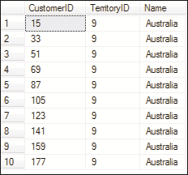
SQL
Server
2012
SQL
Server
2012
The output is shown in the following figure:

Slide 51

SQL
Server
2012
SQL
Server
2012
The real advantage of a stored procedure comes into picture only when one or more parameters are used with it.
This data transfer is done using parameters. Parameters are of two types that are as follows:
Input Parameters
Input parameters allow the calling program to pass values to a stored procedure.
These values are accepted into variables defined in the stored procedure.
Output Parameters
Output parameters allow a stored procedure to pass values back to the calling program.
These values are accepted into variables by the calling program.

Slide 52

SQL
Server
2012
SQL
Server
2012
Values are passed from the calling program to the stored procedure and these values are accepted into the input parameters of the stored procedure.
The input parameters are defined at the time of creation of the stored procedure.
The values passed to input parameters could be either constants or variables.
These values are passed to the procedure at the time of calling the procedure.
The stored procedure performs the specified tasks using these values.
The syntax used to create a stored procedure is as follows:
Syntax:
CREATE PROCEDURE <procedure_name>
@parameter <data_type> AS <sql_statement>
where,
data_type: specifies the system defined data type.
The syntax used to execute a stored procedure and pass values as input parameters is as follows:
Syntax:
EXECUTE <procedure_name> <parameters>

Slide 53

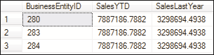
SQL
Server
2012
SQL
Server
2012
Following code snippet creates a stored procedure, uspGetSales with a parameter territory to accept the name of a territory and display the sales details and salesperson id for that territory.
Then, the code executes the stored procedure with Northwest being passed as the input parameter.
CREATE PROCEDURE uspGetSales
@territory varchar(40)
AS
SELECT BusinessEntityID, B.SalesYTD, B.SalesLastYear FROM Sales.SalesPerson A
JOIN Sales.SalesTerritory B
ON A.TerritoryID = B.TerritoryID
WHERE B.Name = @territory;
--Execute the stored procedure EXEC uspGetSales 'Northwest'
The output is shown in the following figure:

Slide 54

SQL
Server
2012
SQL
Server
2012
Output parameters are defined at the time of creation of the procedure.
Also, the calling statement has to have a variable specified with the OUTPUT
keyword to accept the output from the called procedure.
The following syntax is used to pass output parameters in a stored procedure and then, execute the stored procedure with the OUTPUT parameter.
Syntax:
EXECUTE <procedure_name> <parameters>

Slide 55
SQL
Server
2012
SQL
Server
2012
Following code snippet creates a stored procedure, uspGetTotalSales with input parameter @territory to accept the name of a territory and output parameter @sum to display the sum of sales year to date in that territory.
CREATE PROCEDURE uspGetTotalSales
@territory varchar(40), @sum int OUTPUT AS
SELECT @sum= SUM(B.SalesYTD) FROM Sales.SalesPerson A JOIN Sales.SalesTerritory B
ON A.TerritoryID = B.TerritoryID
WHERE B.Name = @territory
Following code snippet declares a variable sumsales to accept the output of the
procedure uspGetTotalSales.
DECLARE @sumsales money;
EXEC uspGetTotalSales 'Northwest', @sum = @sum OUTPUT;
PRINT 'The year-to-date sales figure for this territory is ' + convert(varchar(100),@sumsales);
GO

Slide 56
SQL
Server
2012
OUTPUT parameters have the following characteristics:
The parameter cannot be of text and image data type.
SQL
Server
2012
The calling statement must contain a variable to receive the return value.
 | The variable can be used in subsequent Transact-SQL statements in the batch or the
 | calling procedure.
Output parameters can be cursor placeholders.
The OUTPUT clause returns information from each row on which the INSERT, UPDATE, and DELETE statements have been executed.
This clause is useful to retrieve the value of an identity or computed column after an
INSERT or UPDATE operation.

Slide 57
SQL
Server
2012
SQL
Server
2012
You can also create a user-defined stored procedure using SSMS by performing the following steps:
1
Launch Object Explorer.
2
In Object Explorer, connect to an instance of Database Engine.
3
After successfully connecting to the instance, expand that instance.
Expand Databases and then, expand the AdventureWorks2012 database.
4
Expand Programmability, right-click Stored Procedures, and then, click New Stored Procedure.
5
On the Query menu, click Specify Values for Template Parameters. The Specify Values for Template Parameters dialog box is displayed.
6

Slide 58
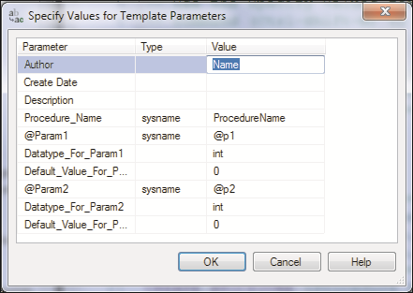
SQL
Server
2012
SQL
Server
2012
This is shown in the following figure:

Slide 59
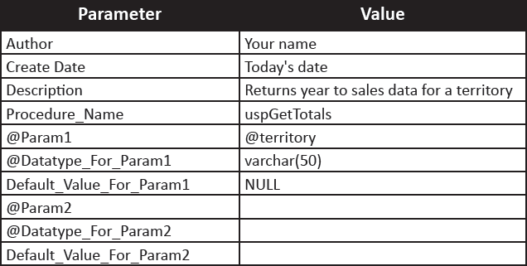
SQL
Server
2012
SQL
Server
2012
In the Specify Values for Template Parameters dialog box, enter the values for the parameters as shown in the following table:
7
8
After entering these details, click OK.

Slide 60
SQL
Server
2012
SQL
Server
2012
9
In the Query Editor, replace the SELECT statement with the following statement:
SELECT BusinessEntityID, B.SalesYTD, B.SalesLastYear
FROM Sales.SalesPerson A JOIN Sales.SalesTerritory B
ON A.TerritoryID = B.TerritoryID WHERE B.Name = @territory;
To test the syntax, on the Query menu, click Parse. If an error message is
returned, compare the statements with the information and correct as needed.
10
To create the procedure, from the Query menu, click Execute. The procedure is
created as an object in the database.
11
To see the procedure listed in Object Explorer, right-click Stored Procedures and select Refresh.
12

Slide 61
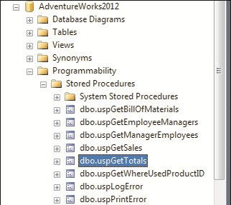
SQL
Server
2012
SQL
Server
2012
The procedure name will be displayed in the Object Explorer tree as shown in the following figure:
To run the procedure, in Object Explorer, right-click the stored procedure name
uspGetTotals and select Execute Stored Procedure.
10
In the Execute Procedure window, enter Northwest as the value for the parameter @territory.
11

Slide 62
SQL
Server
2012
SQL
Server
2012
The definition of a stored procedure can be viewed using the sp_helptext system stored procedure.
To view the definition, you must specify the name of the stored procedure as the parameter when executing sp_helptext.
This definition is in the form of Transact-SQL statements.
The Transact-SQL statements of the procedure definition include the CREATE
PROCEDURE statement as well as the SQL statements that define the body of the procedure.
The syntax used to view the definition of a stored procedure is as follows:
Syntax:
sp_helptext '<procedure_name>‘
Following code snippet displays the definition of the stored procedure named
uspGetTotals.
EXEC sp_helptext uspGetTotals

Slide 63


SQL
Server
2012
SQL
Server
2012
The permissions associated with the stored procedure are lost when a stored procedure is re-created.
A procedure can be altered using the ALTER PROCEDURE statement.
The syntax used to modify a stored procedure is as follows:
Syntax:
ALTER PROCEDURE <procedure_name>
@parameter <data_type> [ OUTPUT ] [ WITH { ENCRYPTION | RECOMPILE } ]
AS <sql_statement>
where,
ENCRYPTION: encrypts the stored procedure definition.
RECOMPILE: indicates that the procedure is compiled at run-time.
sql_statement: specifies the Transact-SQL statements to be included in the body of the procedure.

Slide 64

SQL
Server
2012
SQL
Server
2012
Following code snippet modifies the definition of the stored procedure named uspGetTotals to add a new column CostYTD to be retrieved from Sales.SalesTerritory.
ALTER PROCEDURE [dbo].[uspGetTotals]
@territory varchar = 40 AS
SELECT BusinessEntityID, B.SalesYTD, B.CostYTD, B.SalesLastYear FROM Sales.SalesPerson A
JOIN Sales.SalesTerritory B
ON A.TerritoryID = B.TerritoryID WHERE B.Name = @territory;
GO

Slide 65

SQL
Server
2012
SQL
Server
2012
When a stored procedure is created using options such as the WITH ENCRYPTION option, these options should also be included in the ALTER PROCEDURE statement.
The ALTER PROCEDURE statement alters a single procedure.
When a stored procedure calls other stored procedures, the nested stored procedures are not affected by altering the calling procedure.
The creators of the stored procedure, members of the sysadmin server role and members of the db_owner and db_ddladmin fixed database roles have the permission to execute the ALTER PROCEDURE statement.
It is recommended that you do not modify system stored procedures. If you need to change the functionality of a system stored procedure, then create a user-defined system stored procedure by copying the statements from an existing stored procedure and modify this user-defined procedure.

Slide 66
SQL
Server
2012
SQL
Server
2012
Before dropping a stored procedure, execute the sp_depends system stored procedure to determine which objects depend on the procedure.
A procedure is dropped using the DROP PROCEDURE statement.
The syntax used to drop a stored procedure is as follows:
Syntax:
DROP PROCEDURE <procedure_name>
Following code snippet drops the stored procedure, uspGetTotals.
DROP PROCEDURE uspGetTotals

Slide 67
SQL
Server
2012
SQL
Server
2012
SQL Server 2012 enables stored procedures to be called inside other stored
procedures.
This architecture of calling one procedure from another procedure is referred to as nested stored procedure architecture.
If a stored procedure attempts to access more than 64 databases, or more than two
databases in the nesting architecture, there will be an error.

Slide 68
SQL
Server
2012
SQL
Server
2012
Following code snippet is used to create a stored procedure NestedProcedure that calls two other stored procedures that were created earlier.
CREATE PROCEDURE NestedProcedure AS
BEGIN
EXEC uspGetCustTerritory EXEC uspGetSales 'France' END
When the procedure NestedProcedure is executed, this procedure in turn invokes the uspGetCustTerritory and uspGetSales stored procedures and passes the value France as the input parameter to the uspGetSales stored procedure.

Slide 69
SQL
Server
2012
SQL
Server
2012
The level of nesting of the current procedure can be determined using the
@@NESTLEVEL function.
When the @@NESTLEVEL function is executed within a Transact-SQL string, the value returned is the current nesting level + 1.
If you use sp_executesql to execute the @@NESTLEVEL function, the value
returned is the current nesting level + 2 (as another stored procedure, namely
sp_executesql, gets added to the nesting chain).
Syntax:
@@NESTLEVEL
where,
@@NESTLEVEL: Is a function that returns an integer value specifying the level of
nesting.

Slide 70
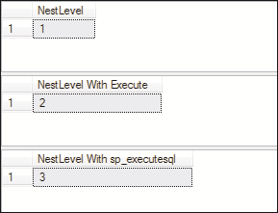
SQL
Server
2012
SQL
Server
2012
Following code snippet creates and executes a procedure Nest_Procedure that executes the @@NESTLEVEL function to determine the level of nesting in three different scenarios.
CREATE PROCEDURE Nest_Procedure
AS
SELECT @@NESTLEVEL AS NestLevel;
EXECUTE ('SELECT @@NESTLEVEL AS [NestLevel With Execute]');
EXECUTE sp_executesql N'SELECT @@NESTLEVEL AS [NestLevel With sp_executesql]';
Code Snippet 44 executes the Nest_Procedure stored procedure. Code Snippet 44:
EXECUTE Nest_Procedure
Three outputs are displayed in the following figure for the three different methods
used to call the @@NESTLEVEL function.

Slide 71






SQL
Server
2012
SQL
Server
2012
This metadata can be viewed using system views, which are predefined views of SQL Server.
These views are grouped into several different schemas as follows:
These contain information about the catalog in a SQL Server system.
A catalog is similar to an inventory of objects.
These views contain a wide range of metadata.
Following code snippet retrieves a list of user tables and attributes from the system catalog view sys.tables.
SELECT name, object_id, type, type_desc FROM sys.tables;

Slide 72



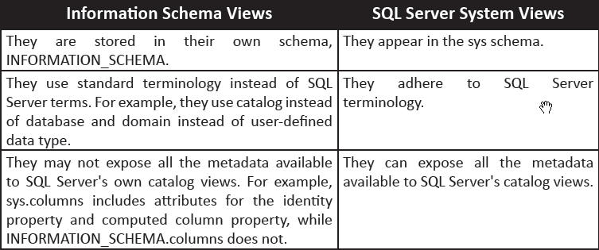
SQL
Server
2012
SQL
Server
2012
These views are useful to third-party tools that may not be specific for SQL Server.
Information schema views provide an internal, system table-independent view of the SQL Server metadata.
Information schema views enable applications to work correctly although significant changes have been made to the underlying system tables.
The points given in the following table will help to decide whether one should query
SQL Server-specific system views or information schema views.

Slide 73


SQL
Server
2012
SQL
Server
2012
Following code snippet retrieves data from the INFORMATION_SCHEMA.TABLES
view in the AdventureWorks2012 database.
SELECT TABLE_CATALOG, TABLE_SCHEMA, TABLE_NAME, TABLE_TYPE FROM INFORMATION_SCHEMA.TABLES;
In addition to views, SQL Server provides a number of built-in functions that return metadata to a query.
These include scalar functions and table-valued functions, which can return information about system settings, session options, and a wide range of objects.
SQL Server metadata functions come in a variety of formats. Some appear similar to standard scalar functions, such as ERROR_NUMBER().
Others use special prefixes, such as @@VERSION or $PARTITION.

Slide 74

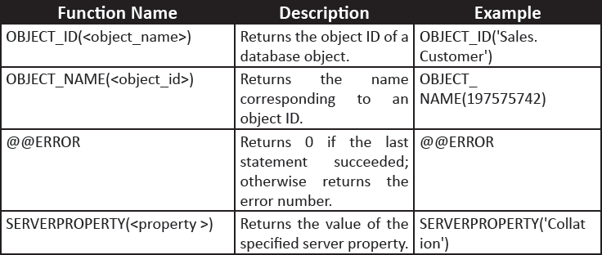
SQL
Server
2012
SQL
Server
2012
Following table shows some common system metadata functions.
Following code snippet uses a SELECT statement to query a system metadata
function.
SELECT SERVERPROPERTY('EDITION') AS EditionName;

Slide 75
SQL
Server
2012
SQL
Server
2012
Dynamic Management Views (DMVs) and Dynamic Management Functions (DMFs) are dynamic management objects that return server and database state information.
They provide useful insight into the working of software and can be used for examining the state of SQL Server instance, troubleshooting, and performance tuning.
SQL Server 2012 provides nearly 200 dynamic management objects.

Slide 76
SQL
Server
2012
SQL
Server
2012
Following table lists the naming convention that helps organize the DMVs by
function.
Naming Pattern | Description
db | database related
io | I/O statistics
Os | SQL Server Operating System Information
"tran" | transaction-related
"exec" | query execution-related metadata
To query a dynamic management object, you use a SELECT statement as you would with any user-defined view or table-valued function.

Slide 77
SQL
Server
2012
SQL
Server
2012
Following code snippet returns a list of current user connections from the
sys.dm_exec_sessions view.
SELECT session_id, login_time, program_name FROM sys.dm_exec_sessions
WHERE login_name ='sa' and is_user_process =1;
sys.dm_exec_sessions is a server-scoped DMV that displays information about all active user connections and internal tasks.
This information includes login user, current session setting, client version, client program name, client login time, and more.
The sys.dm_exec_sessions can be used to identify a specific session and find information about it.

Slide 78
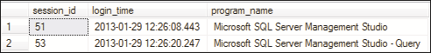
SQL
Server
2012
SQL
Server
2012
Here, is_user_process is a column in the view that determines if the session is
a system session or not.
A value of 1 indicates that it is not a system session but rather a user session.
The program_name column determines the name of client program that initiated the session.
The login_time column establishes the time when the session began.
The output of the code is shown in the following figure:

Slide 79
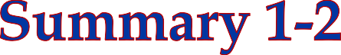
SQL
Server
2012
A view is a virtual table that is made up of selected columns from one or more tables and is created using the CREATE VIEW command in SQL Server.
Users can manipulate the data in views, such as inserting into views, modifying the data in views, and deleting from views.
A stored procedure is a group of Transact-SQL statements that act as a single block of
code that performs a specific task.
SQL Server supports various types of stored procedures, such as User-Defined Stored Procedures, Extended Stored Procedures, and System Stored Procedures.
System stored procedures can be classified into different categories such as Catalog Stored Procedures, Security Stored Procedures, and Cursor Stored Procedures.
Input and output parameters can be used with stored procedures to pass and receive
data from stored procedures.
SQL
Server
2012

Slide 80

SQL
Server
2012
The properties of an object such as a table or a view are stored in special system tables and are referred to as metadata.
DMVs and DMFs are dynamic management objects that return server and database state information.
DMVs and DMFs are collectively referred to as dynamic management objects.
SQL
Server
2012

